Slide 1





New multifracuring model build on improved PKN formulation.
Piotr Kuśmierczyk^{1,2}
¹IMAPS, Aberystwyth University, Ceredigion SY23 3BZ, Wales, U.K.
²EUROTECH Sp. z o.o., ul. Wojska Polskiego 3, 39-300 Mielec, Poland
In collaboration with Gennady Mishuris
This research has been supported by FP7 PEOPLE IAPP Project HYDROFRAC under number 251475.

Slide 2
Plan for this talk:
Improved single fracture PKN model
Multifracturing model build on PKN formulation
Fracture interactions and implementation challenges
Conclusions and future work

Slide 3
Improved single fracture PKN model

Slide 4
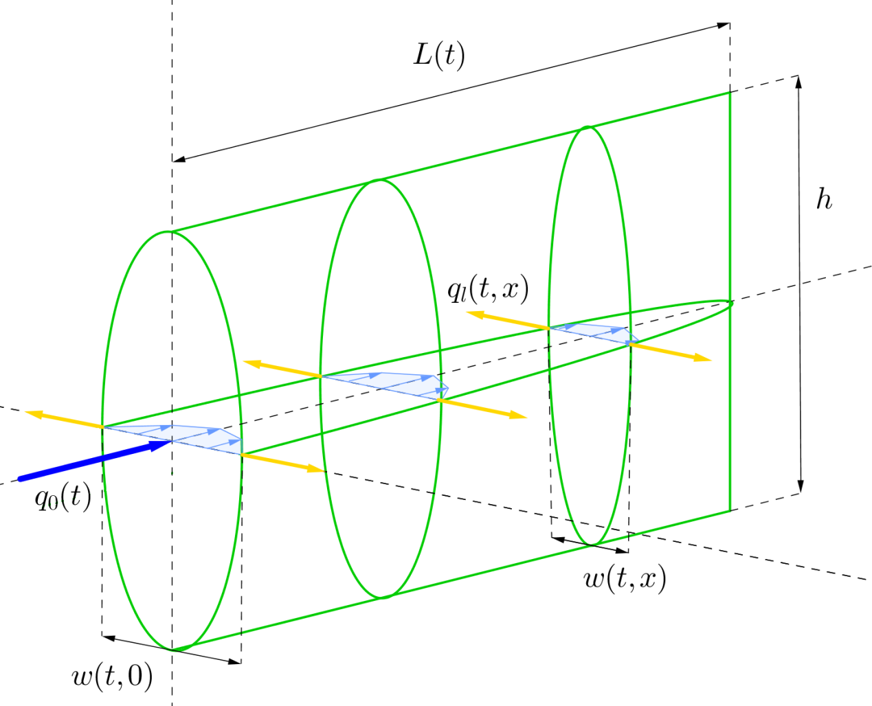
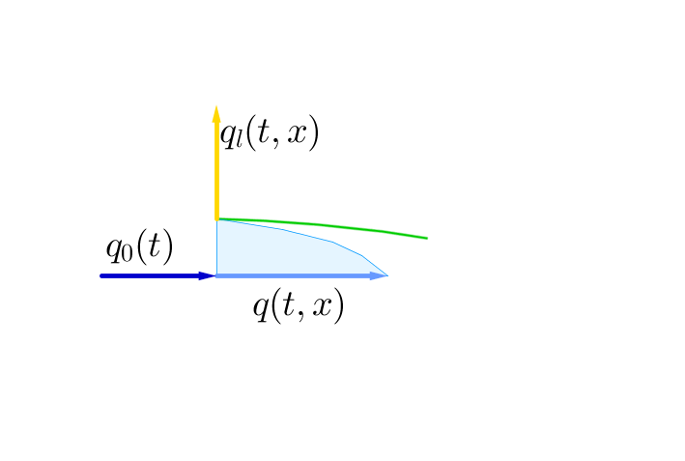
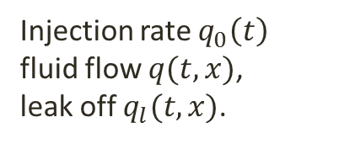
PKN model geometry
Named after Perkins, Kern and Nordgren
fracture length
constant fracture
height
Injection rate $q_{0}\left(t\right)$
fluid flow $q(t,x)$,
leak off $q_{l}(t,x)$.
crack width

Slide 5
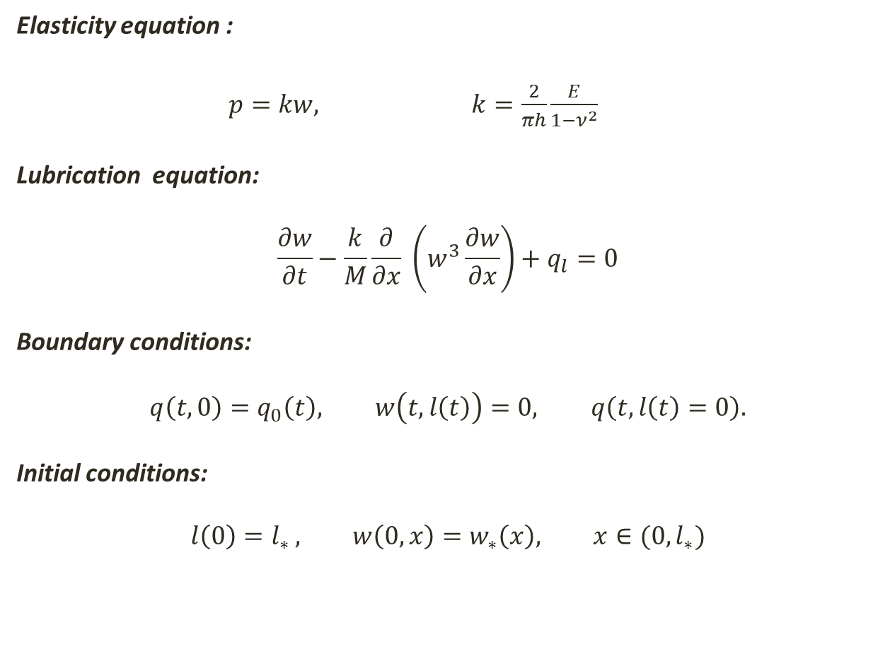
PKN problem formulation
Elasticity equation :
$p=kw,$ $k=\frac{2}{πh}\frac{E}{1−ν^{2}}$
Lubrication equation:
$$\frac{∂w}{∂t}−\frac{k}{M}\frac{∂}{∂x} \left(w^{3}\frac{∂w}{∂x}\right)+q_{l}=0$$
Boundary conditions:
$$q\left(t,0\right)=q_{0}\left(t\right), w\left(t,l\left(t\right)\right)=0, q\left(t,l\left(t\right)=0\right).$$
Initial conditions:
$$l\left(0\right)=l_{∗ }, w\left(0,x\right)=w_{∗}\left(x\right), x∈(0,l_{∗})$$
net pressure
Moving boundary (crack tip)

Slide 6
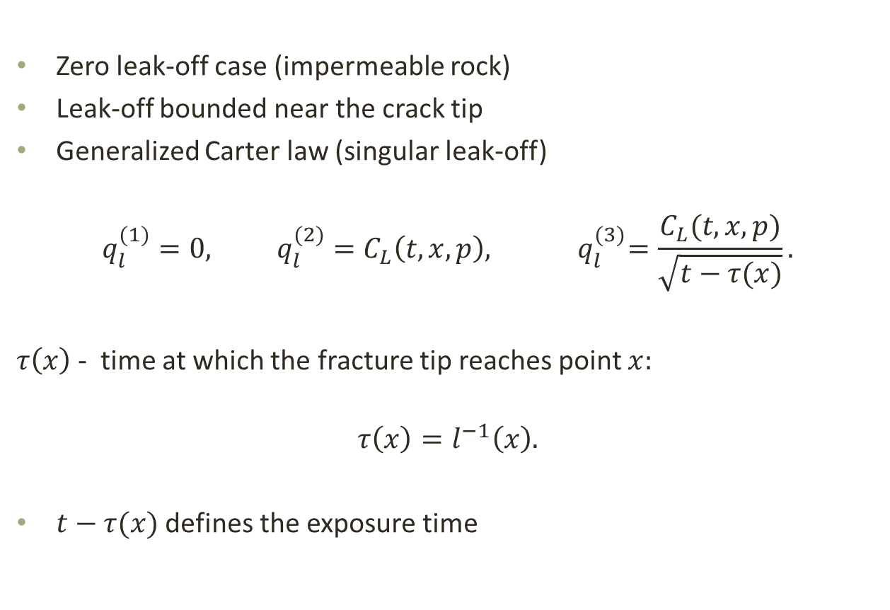
Considered leak-off regimes
Zero leak-off case (impermeable rock)
Leak-off bounded near the crack tip
Generalized Carter law (singular leak-off)
$$q_{l}^{(1)}=0, q_{l}^{(2)}=C_{L}\left(t,x,p\right),{ q}_{l}^{(3)}=\frac{C_{L}(t,x,p)}{\sqrt{t−τ(x)}}.$$
$τ\left(x\right)$ - time at which the fracture tip reaches point $x:$
$$τ\left(x\right)=l^{−1}\left(x\right).$$
$t−τ(x)$ defines the exposure time

Slide 7
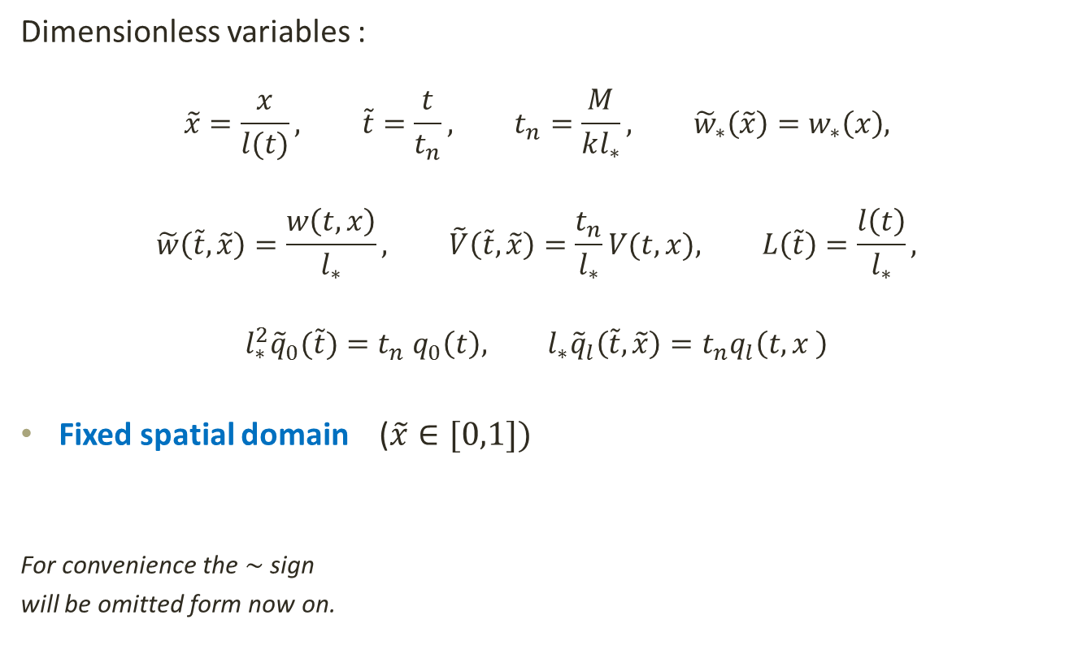
Normalization
Dimensionless variables :
$$\tilde{x}=\frac{x}{l(t)}, \tilde{t}=\frac{t}{t_{n}}, t_{n}=\frac{M}{kl_{∗}^{}}, {\tilde{w}}_{∗}\left(\tilde{x}\right)=w_{∗}\left(x\right),$$
$$\tilde{w}\left(\tilde{t},\tilde{x}\right)=\frac{w\left(t,x\right)}{l_{∗}}, \tilde{V}\left(\tilde{t},\tilde{x}\right)=\frac{t_{n}}{l_{∗}}V(t,x), L\left(\tilde{t}\right)=\frac{l\left(t\right)}{l_{∗}},$$
$${l_{∗}^{2}{\tilde{q}}_{0}(\tilde{t})=t}_{n} q_{0}\left(t\right), l_{∗}{\tilde{q}}_{l}\left(\tilde{t},\tilde{x}\right)=t_{n}q_{l}\left(t,x \right)$$
Fixed spatial domain ($\tilde{x}∈[0,1])$
For convenience the$\sim$ sign
will be omitted form now on.
Excessive normalization may become an issue with many fractures.

Slide 8
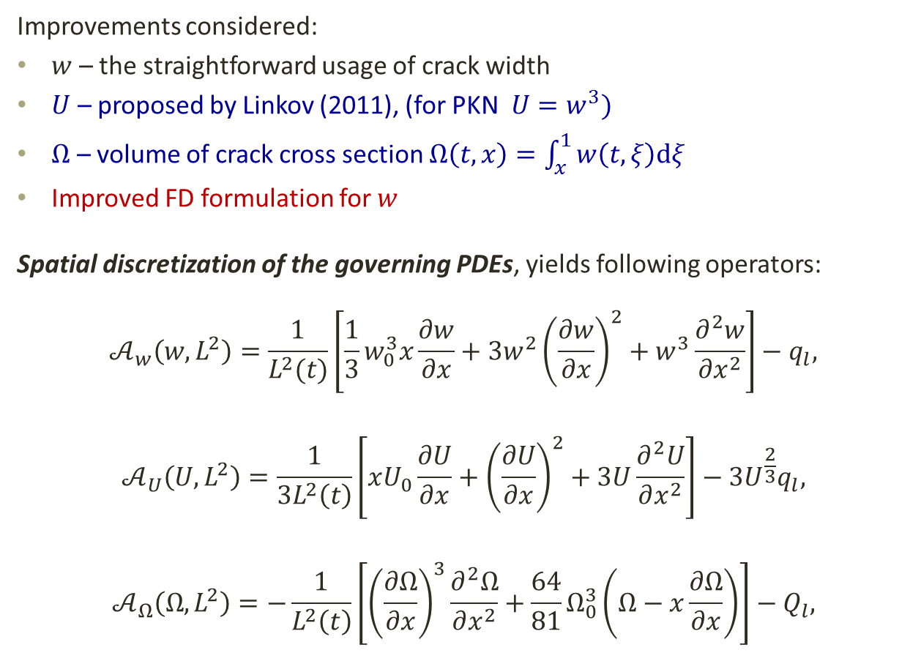
Normalized formulation in different variables
Improvements considered:
$w$ – the straightforward usage of crack width
$U$ – proposed by Linkov (2011), (for PKN $U=w^{3})$
$Ω$ – volume of crack cross section $Ω\left(t,x\right)=\int_{x}^{1}{w\left(t,ξ\right)dξ}$
Improved FD formulation for $w$
Spatial discretization of the governing PDEs, yields following operators:
$$𝒜_{w}\left(w,L^{2}\right)=\frac{1}{L^{2}(t)}\left[\frac{1}{3}w_{0}^{3}x\frac{∂w}{∂x}+3w^{2}{\left(\frac{∂w}{∂x}\right)}^{2}+w^{3}\frac{∂^{2}w}{∂x^{2}}\right]−q_{l},$$
$$𝒜_{U}\left(U,L^{2}\right)=\frac{1}{3L^{2}\left(t\right)}\left[xU_{0}\frac{∂U}{∂x}+{\left(\frac{∂U}{∂x}\right)}^{2}+3U\frac{∂^{2}U}{∂x^{2}}\right]−3U^{\frac{2}{3}}q_{l},$$
$$𝒜_{Ω}\left(Ω,L^{2}\right)=−\frac{1}{L^{2}\left(t\right)}\left[{\left(\frac{∂Ω}{∂x}\right)}^{3}\frac{∂^{2}Ω}{∂x^{2}}+\frac{64}{81}Ω_{0}^{3}\left(Ω−x\frac{∂Ω}{∂x}\right)\right]−Q_{l},$$
proper variables

Slide 9
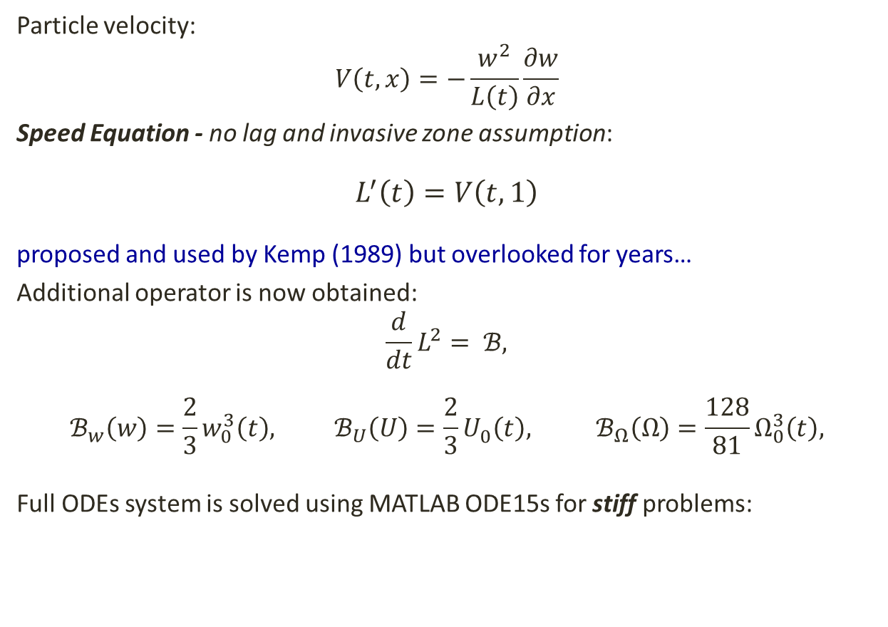
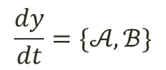
Speed Equation
Particle velocity:
$$V\left(t,x\right)=−\frac{w^{2}}{L\left(t\right)}\frac{∂w}{∂x}$$
Speed Equation - no lag and invasive zone assumption:
$$L^{′}\left(t\right)=V\left(t,1\right)$$
proposed and used by Kemp (1989) but overlooked for years…
Additional operator is now obtained:
$$\frac{d}{dt}L^{2}= ℬ,$$
$$ℬ_{w}\left(w\right)=\frac{2}{3}w_{0}^{3}\left(t\right), ℬ_{U}\left(U\right)=\frac{2}{3}U_{0}^{}\left(t\right), ℬ_{Ω}\left(Ω\right)=\frac{128}{81}Ω_{0}^{3}\left(t\right),$$
Full ODEs system is solved using MATLAB ODE15s for stiff problems:
$$\frac{dy}{dt}=\{𝒜,ℬ\}$$

Slide 10
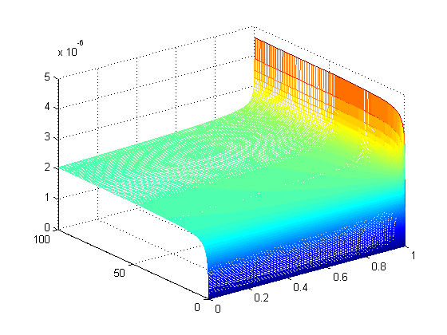
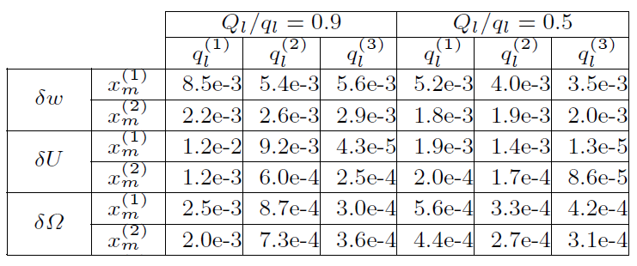
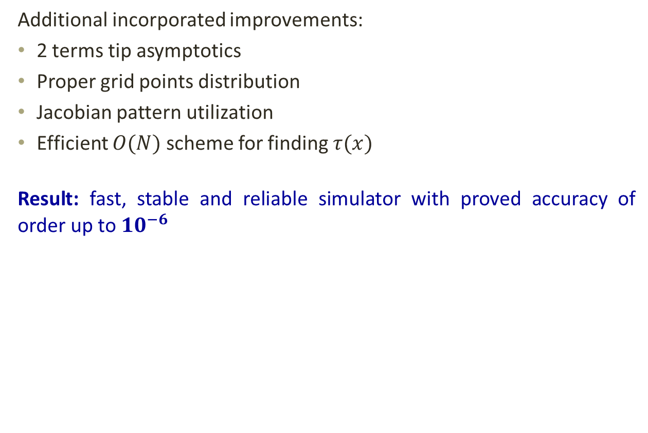
Accuracy of the single fracture PKN approach
Additional incorporated improvements:
2 terms tip asymptotics
Proper grid points distribution
Jacobian pattern utilization
Efficient $O(N)$ scheme for finding $τ(x)$
Result: fast, stable and reliable simulator with proved accuracy of order up to ${10}^{−6}$
P. Kusmierczyk, G. Mishuris , M. Wrobel (2013) Remarks on application of different variables for the PKN model of hydrofracturing: various ﬂuid-ﬂow regimes. Int J Fract 184:185–213

Slide 11
Is this enough for multifracturing ?
Difficulties:
Possible crack closures after fracture intersections
How to simulate fracture interactions?
How to deal with formation toughness?
Numerical challenges

Slide 12
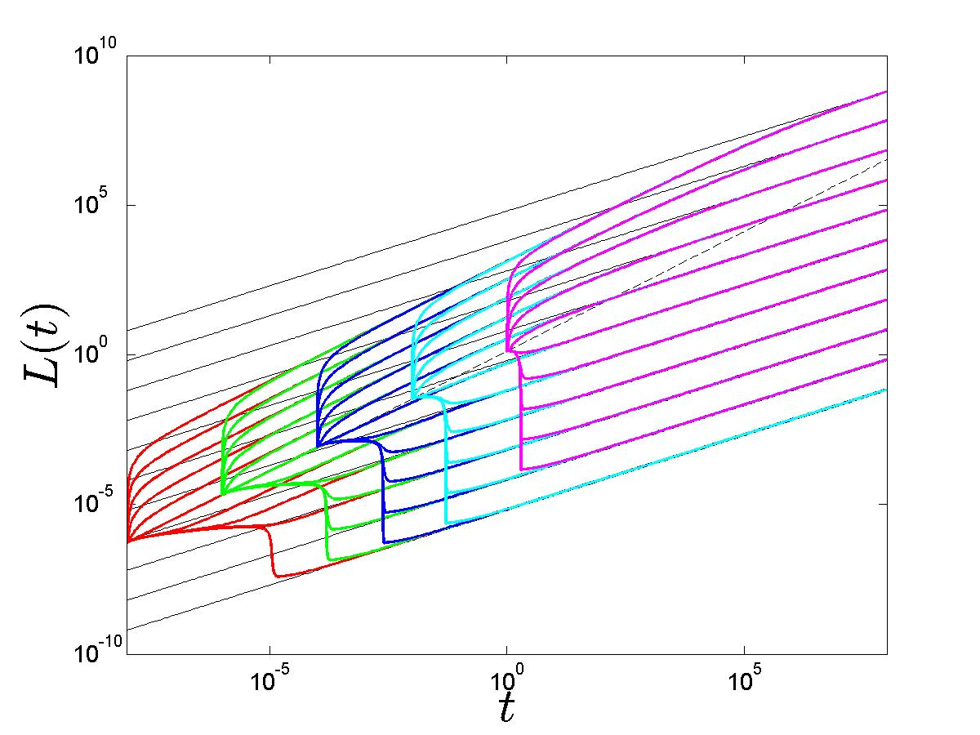
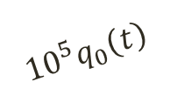
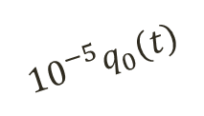
Possible crack closure – initial conditions vs other parameters
$${{10}^{5}q}_{0}\left(t\right)$$
$${{10}^{−5}q}_{0}\left(t\right)$$
closing fractures !!!
solver needed to be modified

Slide 13
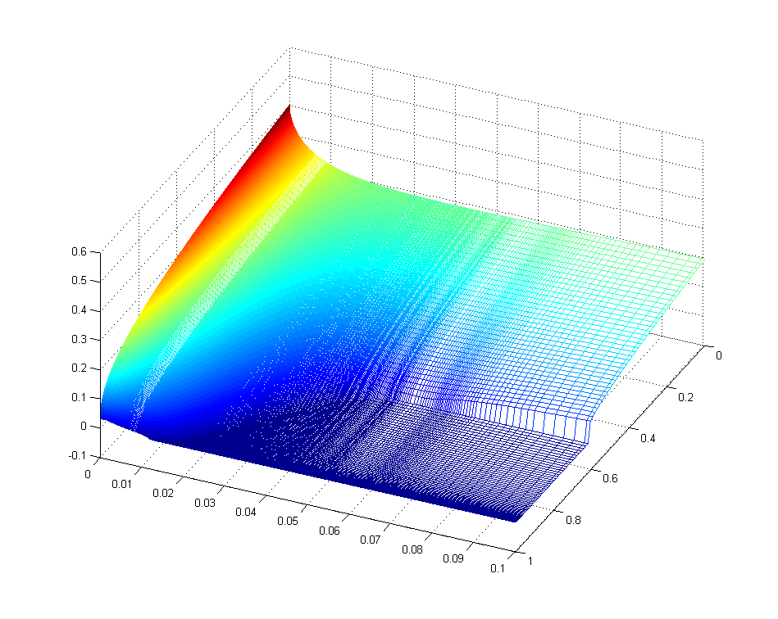
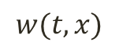
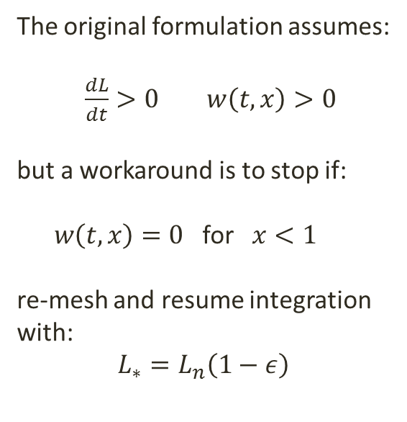
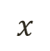
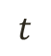
Handling closing fractures, large leak off values
The original formulation assumes:
$\frac{dL}{dt}>0 w\left(t,x\right)>0$
but a workaround is to stop if:
$w\left(t,x\right)=0$ for $x<1$
re-mesh and resume integration with:
$L_{∗}=L_{n}\left(1−ε\right)$
$$w(t,x)$$
$$x$$
$$t$$

Slide 14
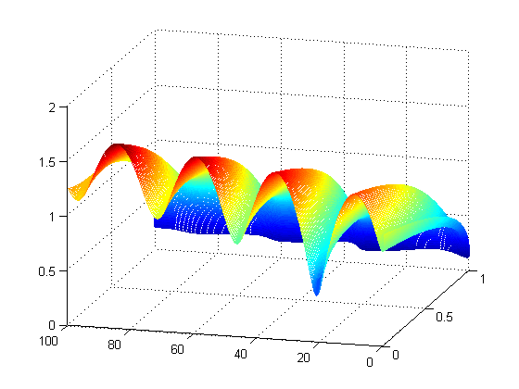
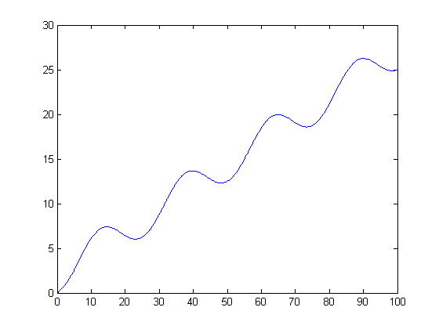
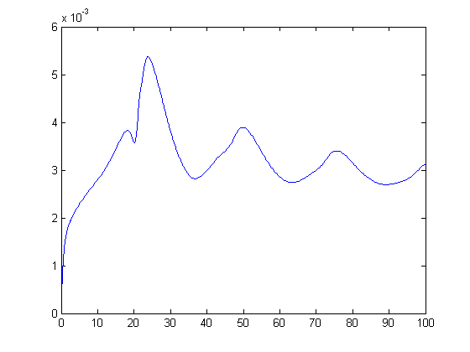
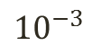
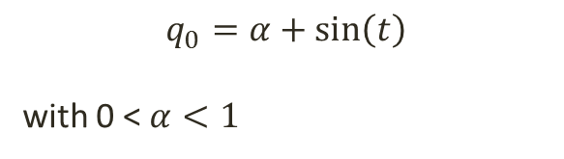
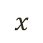
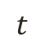
Handling closing fractures, negative pumping
$$q_{0}=α+\sin\left(t\right)$$
with 0 < $α<1$
Total volume pumped in
$$x$$
$$t$$
$${10}^{−3}$$
It works!
Control: Fluid balance in fracture

Slide 15
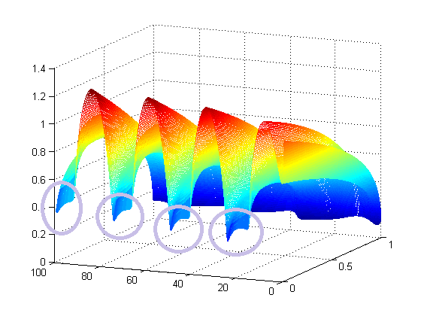
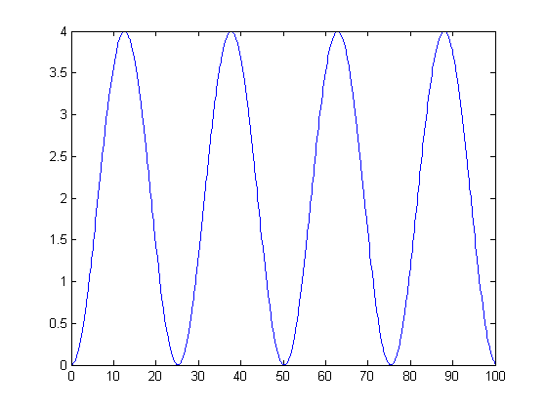
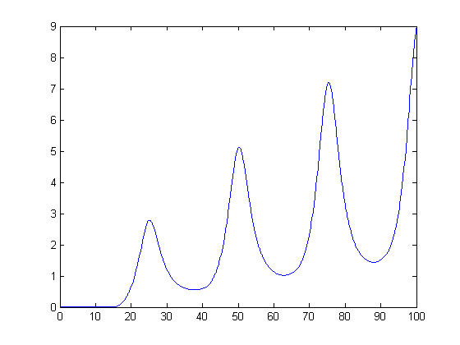
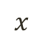


Handling closing fractures, negative pumping
$q_{0}=\sin\left(t\right)$
Total volume pumped in
$$x$$
$$t$$
At some point everything goes wrong…
Fluid balance in fracture

Slide 16
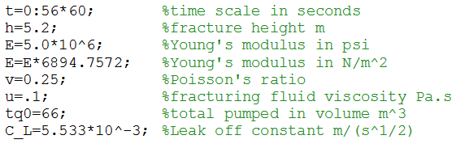
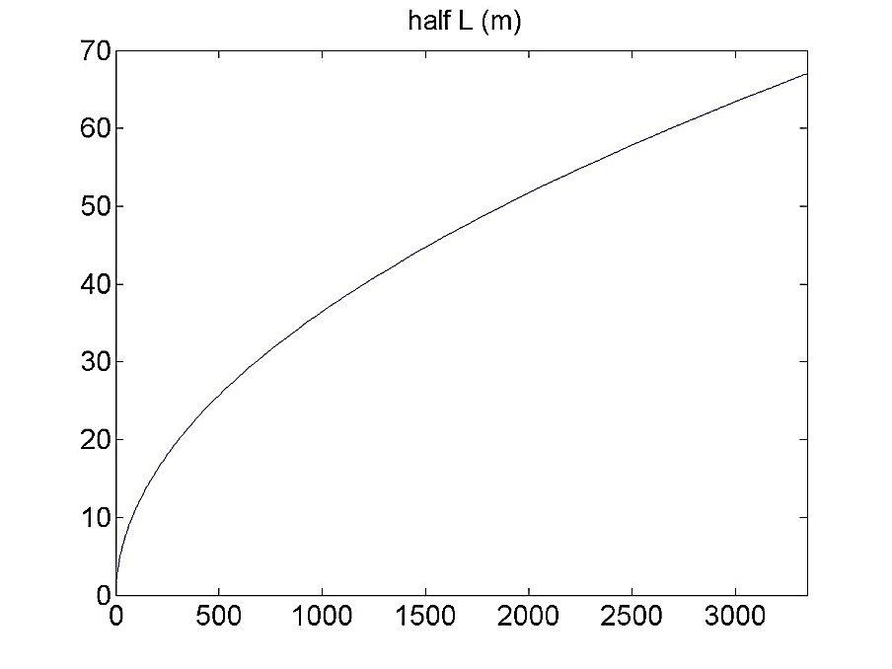
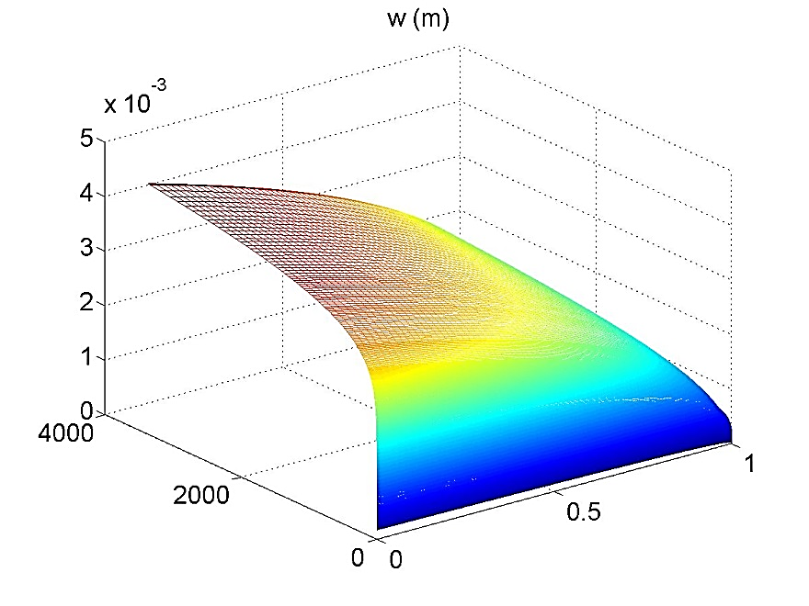
Testing against real life data

Slide 17
Multifracturing model build on PKN formulation

Slide 18
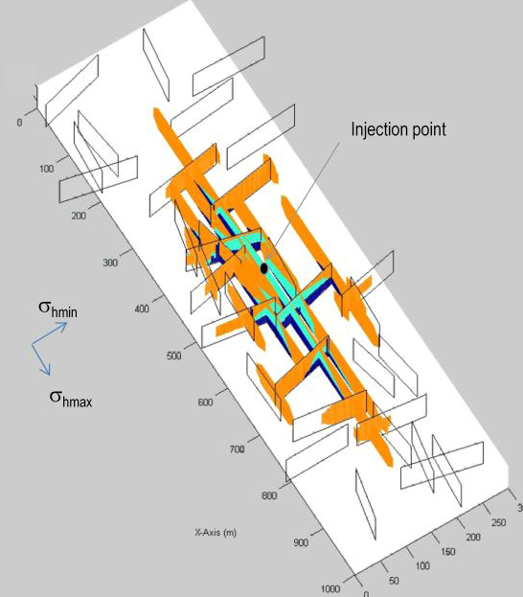
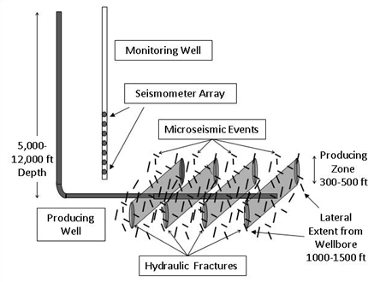
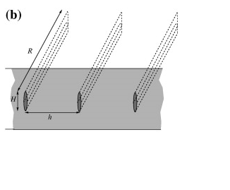
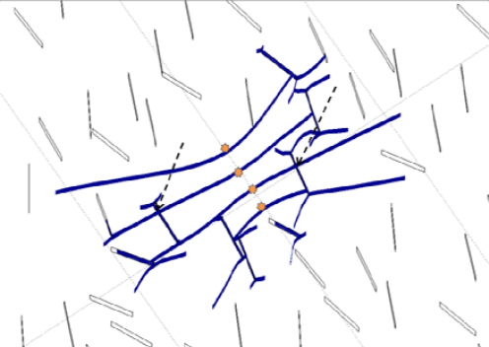
What is “Multifracturing” ?
Weng(2011)
Bunger(2013)
Kresse(2013)

Slide 19
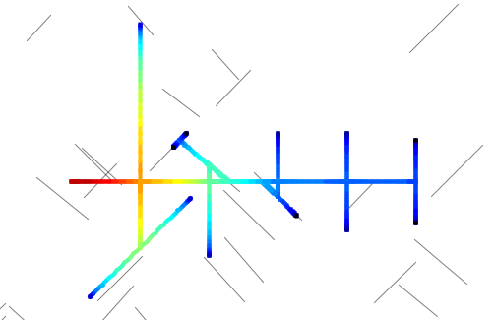
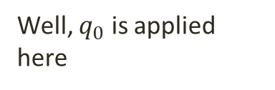
What do I mean by “Multifracturing”
Well, $q_{0}$ is applied here
existing closed crack
PKN like crack
Solid concrete pipe
PKN like “pipe”
Junction

Slide 20
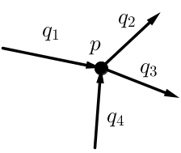
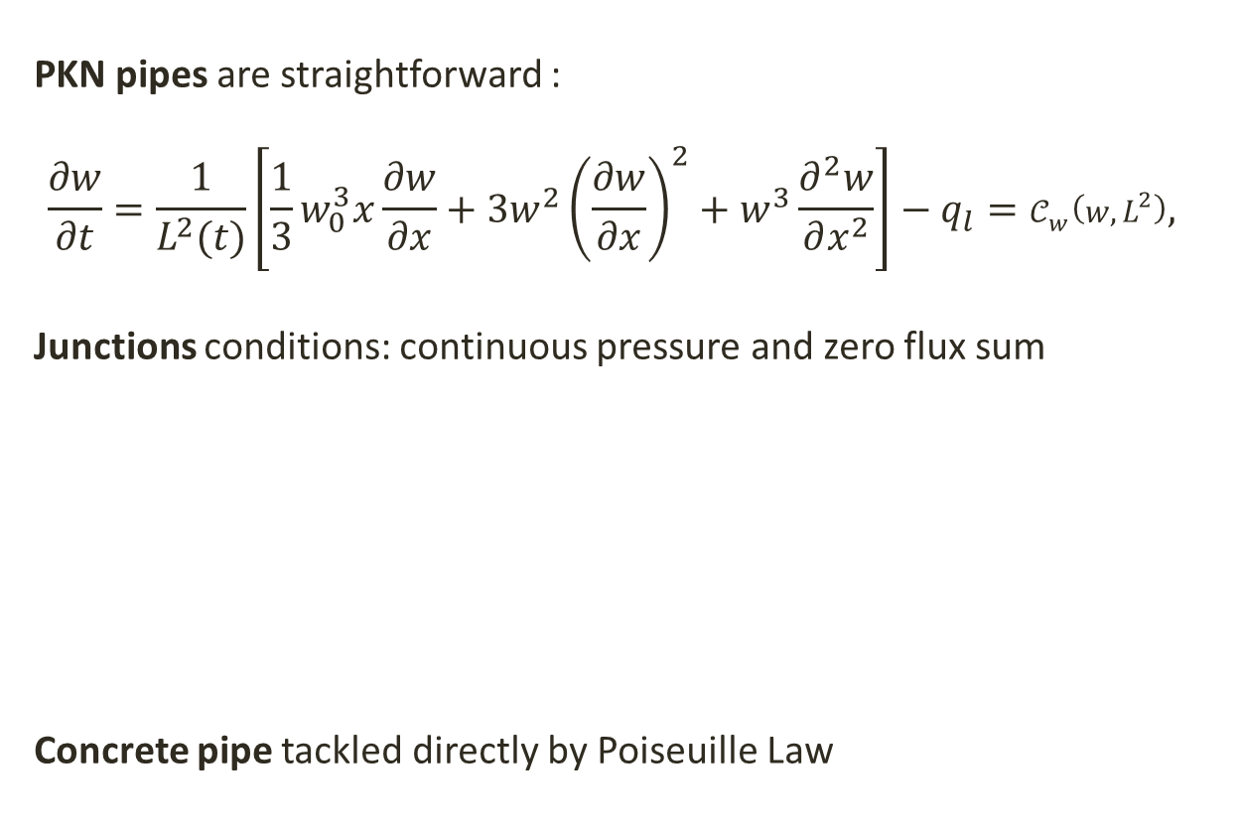
PKN “Pipe” , Junctions and Concrete pipes
PKN pipes are straightforward :
$$\frac{∂w}{∂t}=\frac{1}{L^{2}(t)}\left[\frac{1}{3}w_{0}^{3}x\frac{∂w}{∂x}+3w^{2}{\left(\frac{∂w}{∂x}\right)}^{2}+w^{3}\frac{∂^{2}w}{∂x^{2}}\right]−q_{l}=𝒞_{w}\left(w,L^{2}\right),$$
Junctions conditions: continuous pressure and zero flux sum
Concrete pipe tackled directly by Poiseuille Law

Slide 21
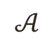
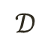
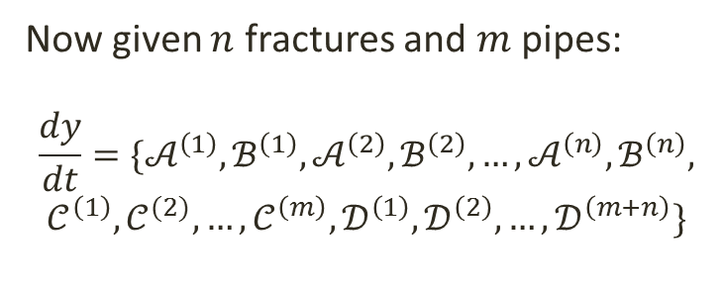
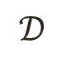
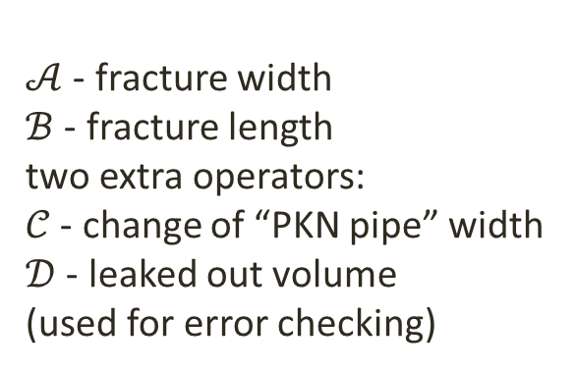
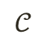
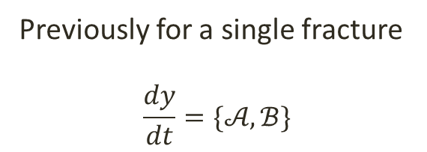
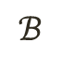
How to make it stick together ?
$𝒜$ - fracture width
$ℬ$ - fracture length
two extra operators:
$𝒞$ - change of “PKN pipe” width
$𝒟$ - leaked out volume
(used for error checking)
$$ℬ$$
$$𝒜$$
$$𝒟$$
$$𝒞$$
$$𝒟$$
Previously for a single fracture
$$\frac{dy}{dt}=\{𝒜,ℬ\}$$
Now given $n$ fractures and $m$ pipes:
$$\frac{dy}{dt}=\{𝒜^{\left(1\right)},ℬ^{\left(1\right)},𝒜^{\left(2\right)},ℬ^{\left(2\right)},…,𝒜^{\left(n\right)},ℬ^{\left(n\right)},$$
$$𝒞^{\left(1\right)},𝒞^{(2)},…,𝒞^{\left(m\right)}, 𝒟^{\left(1\right)},𝒟^{\left(2\right)},…,𝒟^{\left(m+n\right)}\}$$

Slide 22


A little on technical implementation details
Java
Object Oriented
Abstract interface to integration codes (ODE15s, LSODE, GNU GSL, …)
Changeable depended variables
No restrictions on
model size and
geometry.
Note that this is actually a graph.
(very helpful abstraction)

Slide 23





How well does it work so far ?
relative fluid balance stable around ${10}^{−3}$

Slide 24



Crack collisions and splits
Requirements:
Fluid balance must remain stable
Extrapolation of new grid points
Adjustment of newly created
initial conditions
Model stops integration, re-meshes and then resumes.
The goal is to be able to continue computations from every possible scenario.
relative fluid balance still stable around ${10}^{−3}$

Slide 25
Fracture interactions and implementation challenges

Slide 26


Backstress fracture interactions
Originally $p$ is the net fluid pressure:
$p_{net}=p_{fluid}−σ_{0}$ $−σ_{l}$
Where $σ_{0}$ is the uniform backstress.
An additional term $σ_{l}$ , the stress from other neighboring fractures should also be considered:
$$𝒜_{w}\left(w,L^{2}\right)=\frac{k}{{ML}^{2}(t)}\left[\frac{1}{3}w_{0}^{3}x\frac{∂w}{∂x}+3w^{2}{\left(\frac{∂w}{∂x}\right)}^{2}+w^{3}\frac{∂^{2}w}{∂x^{2}}\right]$$
$$−\frac{1}{ML^{2}\left(t\right)}\left(3w^{2}\frac{∂w}{∂x}\frac{∂σ_{l}}{∂x}+w^{3}\frac{∂^{2}σ_{l}}{∂x^{2}}\right) −q_{l},$$
How to find $σ_{l}$ ? (nothing like this in the original PKN model)

Slide 27




How to find $σ_{l}$ ?
Approximations for far field and close parallel influence were derived by Bunger (2013), which in PKN case can be interpreted as:
$σ_{l}^{(1)}=\frac{3}{8}p\frac{H_{m}^{2}}{h_{m}^{2}}$
$σ_{l}^{(2)}=\frac{L\int_{0}^{1}{w dx}}{h_{m}^{3}}$
We propose similar generalized scheme:
$σ_{l}^{(j)}=\frac{gkw_{j}Δx_{j}L_{j}}{d^{3}}\left(\hat{n_{j}}⋅\hat{σ}\right)⋅\left(\hat{n_{i}}⋅\hat{σ}\right)$

Slide 28






How to find $σ_{l}$ ? 2D visibility problem
Fracture neighbors must be found. This is quite complex calculation, an existing algorithm is adopted.
For every grid point:
casts rays to each vertex
sorts these vertexes by ray angles
maps connected edges to interval $θ∈\left(0,2π\right)$
the closest edge in each interval is the visible one
The cost for one grid point is only $O\left(m\log{m}\right)$
(depends on number of vertexes)
$$θ$$

Slide 29




Jacobian Pattern
FD discretization
+ joint conditions
+ backstress interactions

Slide 30









Speeding up computations
Recent publications call for better CPU performance, so consider these two ideas:
Work on several orders of magnitude smaller $m$ by $m$ matrix for fracture interactions
Parallelize code, one thread per each fracture.
$m$ by $m$
18 entries
$mN$ by $mN$
40832 entries
100 times faster !!!

Slide 31
Conclusions
Fast and accurate PKN solver was built
Crack closures can be handled
This solver was expanded for multifracturing with preexisting natural fractures.
Fracture interactions were introduced (mimicking the real ones).
Dramatic speed up can be achieved through some optimization.
Writing code is at least as challenging as mathematical formulation.
Wide range of scenarios can be tackled, various future case studies could be done.
Fracture toughness will be included.
Fracture collision scenarios will be further enriched and calibrated
Detailed description of this work with code should be published soon.

Slide 32

The End

Slide 33


Collision models
Dimitry Chuprakov, Olga Melchaeva and
Romain Prioul
“Hydraulic Fracture Propagation Across a Weak Discontinuity Controlled by Fluid Injection”

Slide 34


Interesting fracturing scenarios
With these performance improvements,
even larger structures can be handled in real time

Slide 35






How to test if the produced results are valid ?
Split benchmark into pipe and crack segment
Try simple geometries
Check the total fluid balance
$$\int_{0}^{L}{(w}−w_{∗})dx −\int_{0}^{L}{q_{0} dx}+\int_{0}^{L}{\int_{0}^{t}{q_{l} dtdx}=0}$$
$$q_{0}$$
$$−q_{0}$$

Slide 36



Interesting fracturing scenarios
Now consider this coupled array with neighboring fracture influence enabled

